Slide 1
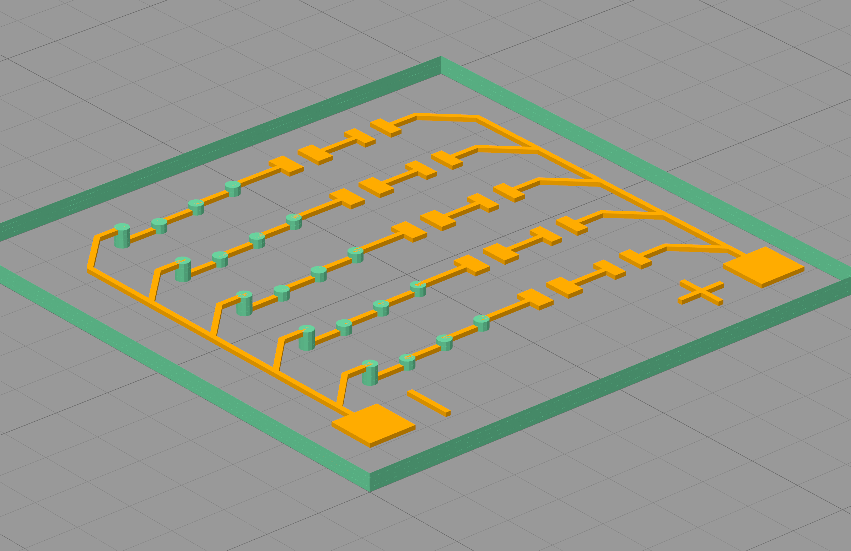
pad
Dielectric material, nozzle #1
trace
Conductive material, nozzle #2
Feature#1: trace
Film files
Extract
Feature#2: pads
Feature#3: patterns (possible)
pattern
via-infill
Feature#4: Via-infills
Via files
Extract
Feature#5: Dielectric plates with via-holes and boundaries
Generate
Feature#6: Dielectric base plate without via-hole
Drill files

Slide 2
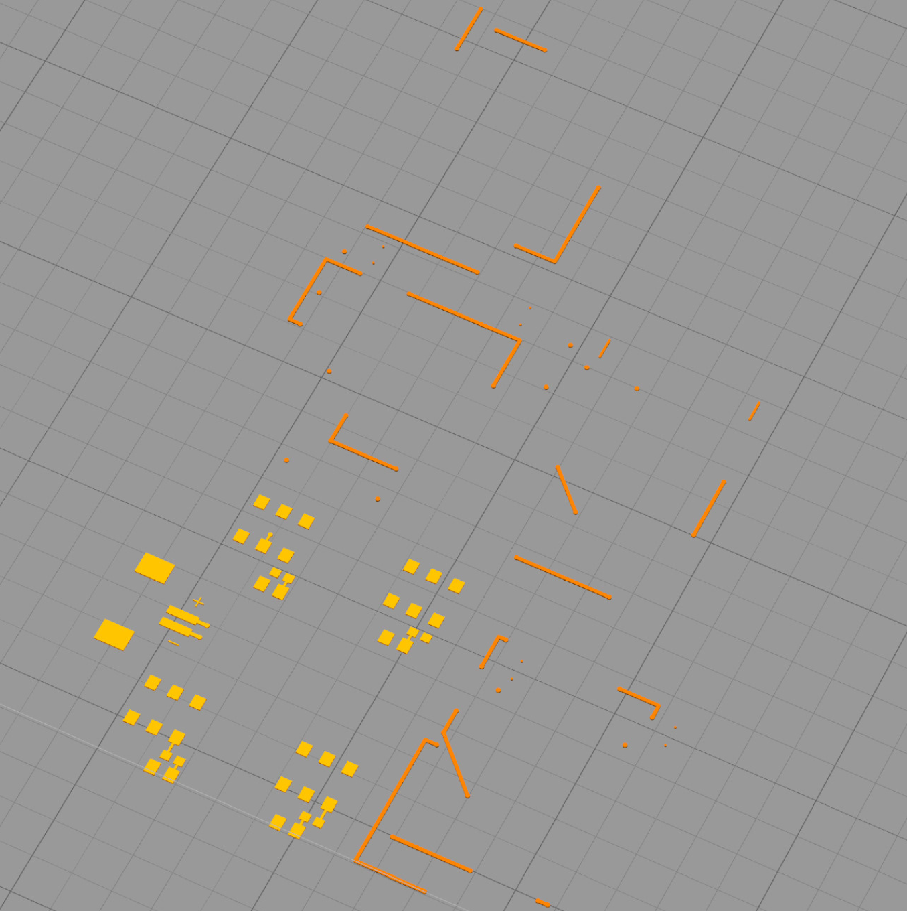
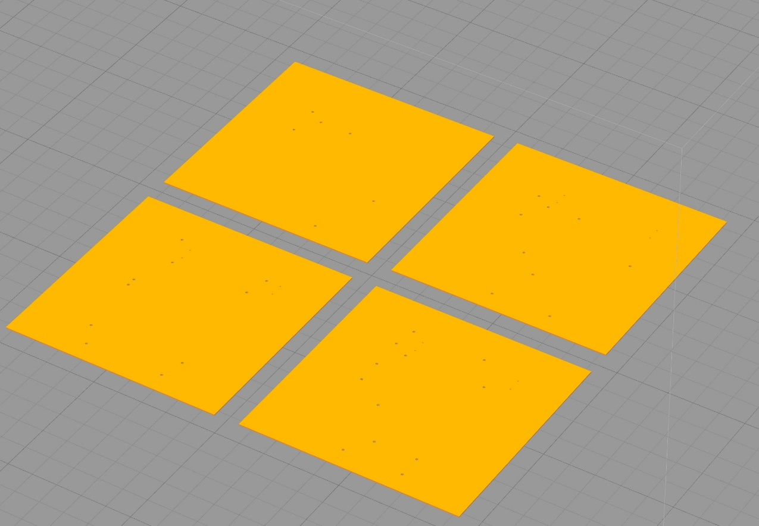
Unstacked conductive film layers
Unstacked dielectric substrate layers

